Slide 1
PROFESSIONAL ETHICS CE 3142 Emerging ethical issues in the field of engineering
Faculty of Engineering,
The General Sir John Kotelawala Defence University
26th April 2024

Slide 2
TOPICS
What is emerging technology?
Uses and Abuses !!
Security
Legal System
Religion
Safe road use
Hi-tech financial abuse
Biometric Technology
Hi-tech road safety
Artificial Intelligent Weaponry
Ethical Dilemma
Breakthrough Technologies – 2020 to 2018

Slide 3
What is emerging technology?
Emerging technologies are technologies that are new, innovative, and still in development, and are expected to have a large socioeconomic impact.
They are new in the sense that they employ new concepts, methods and techniques and cannot be included under existing technologies.
They are innovative in the sense that they promise new and potentially superior solutions to problems.
They are expected to have a large socioeconomic impact in that they are expected to generate significant economic value and activity,
Examples of entrenched technologies are automotive technology, satellite technology, antibiotics, polymer technology, radio technology, information technology, and nuclear technology

Slide 4
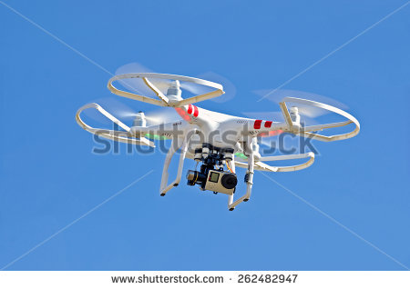
Real-time satellite surveillance
1984, is a novel written by English author George Orwel and published in 1949. The novel is set in Airstrip One, a totalitarian state, which was formerly Great Britain, a province of the superstate Oceania,. The residents are victims of perpetual war, omnipresent government surveillance and public manipulation.
“ In the far distance a helicopter skimmed down between the roofs, hovered for an instant like a bluebottle, and darted away again with a curving flight. It was the police patrol,
snooping into people's windows.” (1.1.4)
Oceanians are used to living in a constant state of surveillance
– either through the use of advanced, invasive technology
or police patrol.

Slide 5
Real-time satellite surveillance
What if Google Earth gave you real-time images instead of a snapshot 1-3 years old?
Many companies have launched dozens of compact, sophisticated satellites in the recent past with the goal of recording the status of the entire Earth in real time (or near real-time).
Commercial satellite companies make this data available to corporations or private citizens, allowing clients to see useful images of areas coping with natural disasters and humanitarian crises, but also data on the comings and goings of private citizens.
How do we decide what should be monitored and how often? Should we use this data to solve crimes?
What is the potential for abuse by corporations, governments, police departments, private citizens, or terrorists and other “bad actors”?

Slide 6
Commercial use of uavs (drones)
LAND SURVEYING
Drones have made it possible to do site surveying more accurately and in less time. The information can be analyzed and processed in shorter time because the process is automated with drones.
SEARCH AND RESCUE
In 2014, drones were introduced as a critical tool for locating people in areas ravaged by fire, earthquakes, floods, or other natural disasters. Drones can be equipped with sensors like infrared that can be used to locate humans in remote areas by their heat signatures.
GPS information allows for precise location and use of aerial support to rescue people.
AGRICULTURE
Drones make it possible for farmers to be able to address hydration issues by measuring water content of soil., helping farmers if they have drainage issues or irrigation problems.
Drones also used to help farmers measure how fast their crops are growing in remote fields.
Drones can be used to detect the presence of crop-wrecking bugs and then even deploy hyper accurate pesticide applications instead of spraying an entire field.
With GPS technology, drones can be used take livestock out to pasture and keep the herd together.

Slide 7
Communications
The ethics issue: Should we abandon privacy online?
The battle between online privacy and national security is reaching fever pitch.
Maximise human happiness vs Maximise human safety
In an age where fear of terrorism is high in the public consciousness, governments are likely to err on the side of safety. Over the past decade, the authorities have been pushing for – and getting – greater powers of surveillance than they have ever had, all in the name of national security.
The downsides are not immediately obvious. After all, you might think you have nothing to hide. But most of us have perfectly legal secrets we’d rather someone else didn’t see. Fortunately the chances of the authorities turning up to take you away in a “white van” on the basis of your Facebook or WhatsApp messages, are small in free societies,

Slide 8
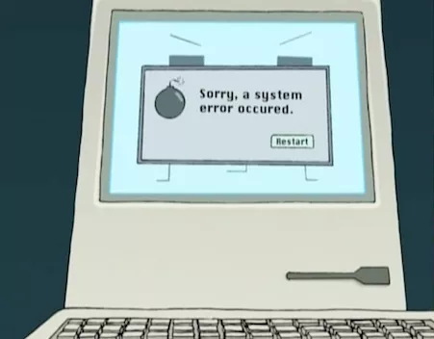
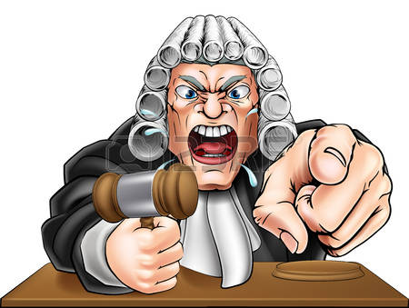
Sentencing software
VS
COMPAS is a program sold by Northpointe, Inc. and marketed as a means to guide courts in their sentencing. The program incorporate key scales from several of the most informative theoretical explanations of crime and delinquency…”
A judge need only plug in all of the relevant information for the case and the algorithm spits out a “more integrated and coherent
interpretation of each person’s support needs.”
Your fate decided by a computer?
Maybe that doesn’t sound so bad when you take into account the bias of judges and the proof that sentences are often influenced by race, class, gender, personal experience, and what the judge had for lunch.
Is it possible that our justice system would become fairer if we handed it over to Artificial Intelligence?
It’s important to remember that algorithms are written by coders, people who have biases that they may not even realize (as do judges).

Slide 9
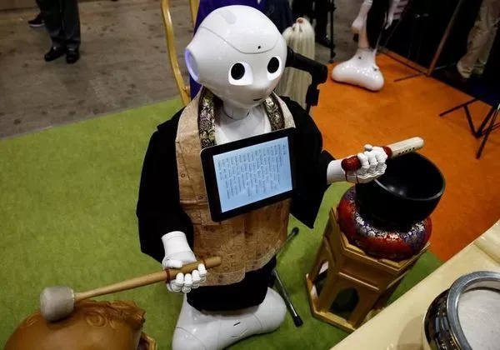
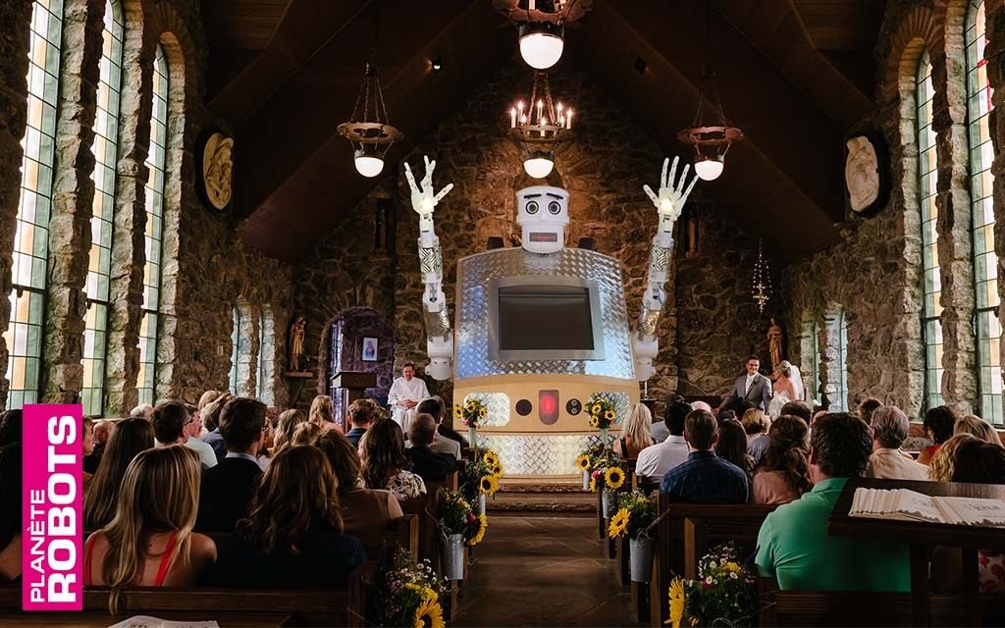
The Robot Priest
Japan’s SoftBank Robotics is producing a new line of Pepper robot Buddhist monks. Pepper can deliver blessings and beat on a drum
The robot [Bless U-2] was built to deliver blessings in 5 languages, while moving its arms and flashing lights.
One of its clergymen-creators, specifically said a robot could not hope to provide the pastoral care of a priest
The plan is to have these monks deliver funeral rites to the exploding elderly population in Japan for about 1/5th of the cost of a human-led, traditional funeral. This brings up an interesting question – could a robot be a legitimate addition to religious services in places where, and to people who, have no alternative?
Is nothing sacred ??

Slide 10
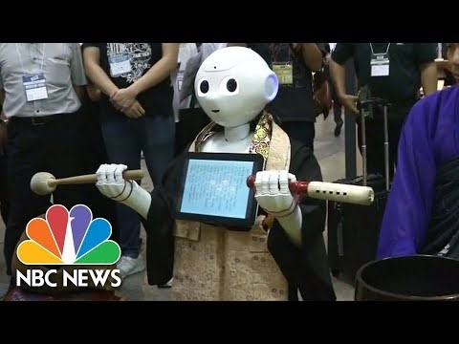

Slide 11
The Textalyzer
Distracted driving is becoming increasingly problematic all over the world and automobile accident fatality rates have increased dramatically
The suspected culprit… texting and driving.
Not only texting, but also Snapchatting, rifling through your playlist, checking e-mail, Tweeting, Facebooking, adjusting Google Maps, and scrolling through the Internet.
One proposed solution is a machine dubbed the “Textalyzer.”, which would give police officers the ability to access a driver’s phone after a crash or traffic accident to see if they were using the device in the time leading up to the crash. The officer would plug the Textalyzer into the driver’s cell phone and retrieve a history of what they’ve been up to.
We all want safer roads. Is this the only way to get them?

Slide 12
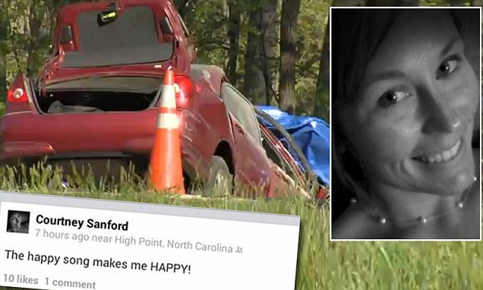
The Textalyzer
ETHICAL CONCERNS :
Violation of Fundamental Rights
Does the use ot this device infringes on our right to be exempt from unreasonable searches and seizures.
How it will be implemented,
How the police will avoid profiling and unequal treatment while using it,
What will happen to people who “fail” the scan, and
How we can avoid seizing a phone used by a passenger instead of a driver.
On April 26, 2014, at 8:33 AM, Courtney Sandord uploaded a selfie of herself on the social network website Facebook with the caption, “The Happy Song makes me so HAPPY”.
Within one minute, at 8:34AM, her car crashed head-on with a truck, on impact, her car caught fire, and she perished.
This again proves how careful all of us have to be on the road, and never to text/call/use mobile phone while driving.

Slide 13
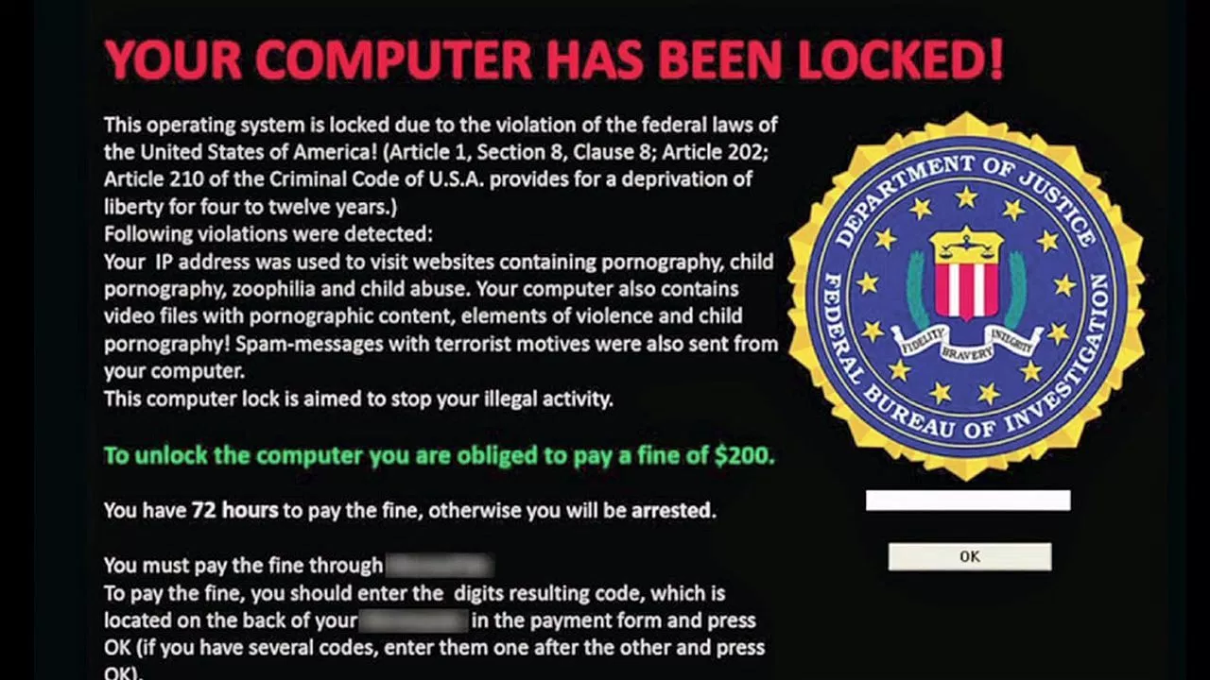
Ransomeware
At its most basic, RANSOMWARE is like a virus that can get into your computer, system, or database, and encrypt your files so you can no longer read them. The ransomers then ask for money in return for the encryption key.
In addition to making money, some malware uses ransom as a distraction while another program irrevocably erases your hard drive.
The Dark Web currently has about 45,000 ads for RANSOMWARE for sale. A lot of it is designed to hit regular citizens. Since many of us blend our business and personal communications, the attacks can get pretty awkward. .
Then there are the big attacks. The CEO of South Korean web design company was forced to pay $1 million (converted into Bitcoin) to attackers when they stole his customers’ information this year.
Ransoms are often paid in Bitcoin because it is protected by blockchain technology, so there’s no way to trace the money.
Google found evidence that attackers have made about $25 million over the last two years, enough to make it a profitable business venture

Slide 14
BIOMETRIC Technology
Humans are unique, and this feature has been used for many years t0 identify people e.g. finger-prints
In recent times with the growth of IT, electronics and allied technologies, more sophisticated means have been developed
- facial, voice, palm, eye, finger, etc
Biometrics represents a huge advancement from the old use of paper documentation like ID cards, passports, and visas. Biometrics provide a very convenient form of identity.
Biometrics are also unique. Unlike your name, your fingerprints, irises, and face are identifiers that belong to you and no one else. IDs or docs can be forged, and passwords can be breached. It’s much harder for a would-be identity thief to capture and use your biometric signature.

Slide 15
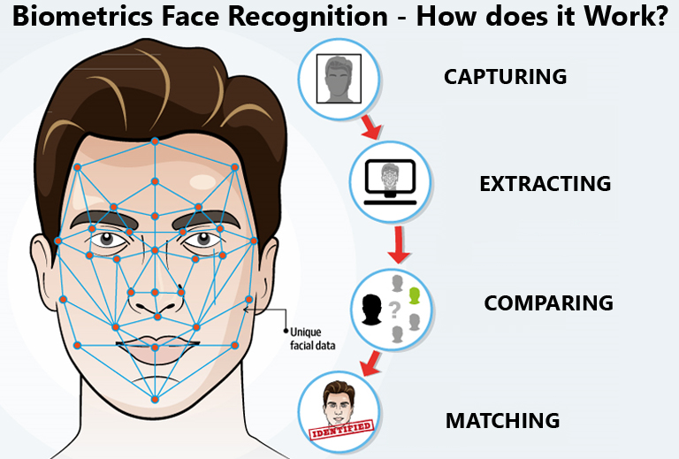
BIOMETRIC Technology
A facial recognition system is a computer application for automatically identifying or verifying a person from a two- or three-dimensional digital image or a frame from a video source. It is typically used in security systems alone or in combination with other factors. Can also be used to perform liveness detection.

Slide 16
BIOMETRIC Technology – Ethical Issues
the downsides of biometrics – the stunning lack of privacy and consumer protection.
Privacy issues are at the heart of the ethical issues of biometrics
(i) personal, not others, public or group;
(ii) unwilling to let others know, or others cannot interfere.
Since biometrics are permanent, difficult to change, and generally visible to others, once they are leaked or forged, they cannot be reset, which poses a greater security risk and aggravated privacy issues. Therefore, biometric information should be treated as sensitive data
Autonomy - exercising autonomy involves informed consent .
At present, personal information (including biometric information) is secretly collected without the knowledge of individuals due to advances in surveillance technology and the potential for remote sensing of certain biometric technologies.
(i) should have informed consent in the application,
(ii) should be fully informed of potential risks; and
(ii) be able to understand the possible affects of their actions

Slide 17
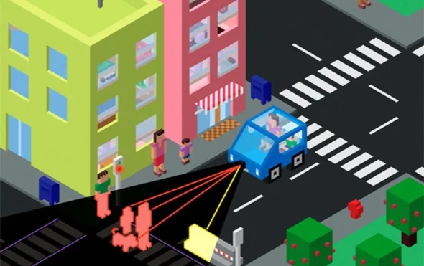
Self-driving cars
A self-driving car carrying a family of four on a rural two-lane highway spots a bouncing ball ahead. As the vehicle approaches a child runs out to retrieve the ball. Should the car risk its passengers’ lives by swerving to the side—where the edge of the road meets a steep cliff? Or should the car continue on its path, ensuring its passengers’ safety at the child’s expense ??
Should the vehicle be programmed to crash into something
rather than run over pedestrians, even if that
meant killing the vehicle’s passengers ??
The algorithms that control [autonomous vehicles]
will need to embed moral principles guiding their
decisions in situations of unavoidable harm,

Slide 18
self-driving cars
Artificial Intelligence does not have the same cognitive capabilities that humans have !!
Instead, autonomous vehicles make decisions based on speed, weather, road conditions, distance and other data gathered by a variety of sensors, including cameras, LiDARS and radars. A driverless car will calculate a course of action based on how fast it is traveling as well as the speed of an object in its path, for example, the main challenge is in gathering and processing the necessary data quickly enough to avoid dangerous circumstances in the first place.
This will not always be possible, but in such cases it may come down to the vehicle essentially deciding who lives and who dies.
The bigger concern about autonomous vehicles is the ability to keep them protected from hackers who might want to take over their controls while someone is onboard.
if lawmakers were to prioritize pedestrians over passengers when regulating self-driving vehicles, people would be less likely to buy those vehicles. A shrinking market for driverless cars would slow their development despite research showing that autonomous vehicles could potentially reduce traffic, cut pollution and save thousands of lives each year—human error contributes to 90% of traffic accidents

Slide 19
self-driving cars

Slide 20
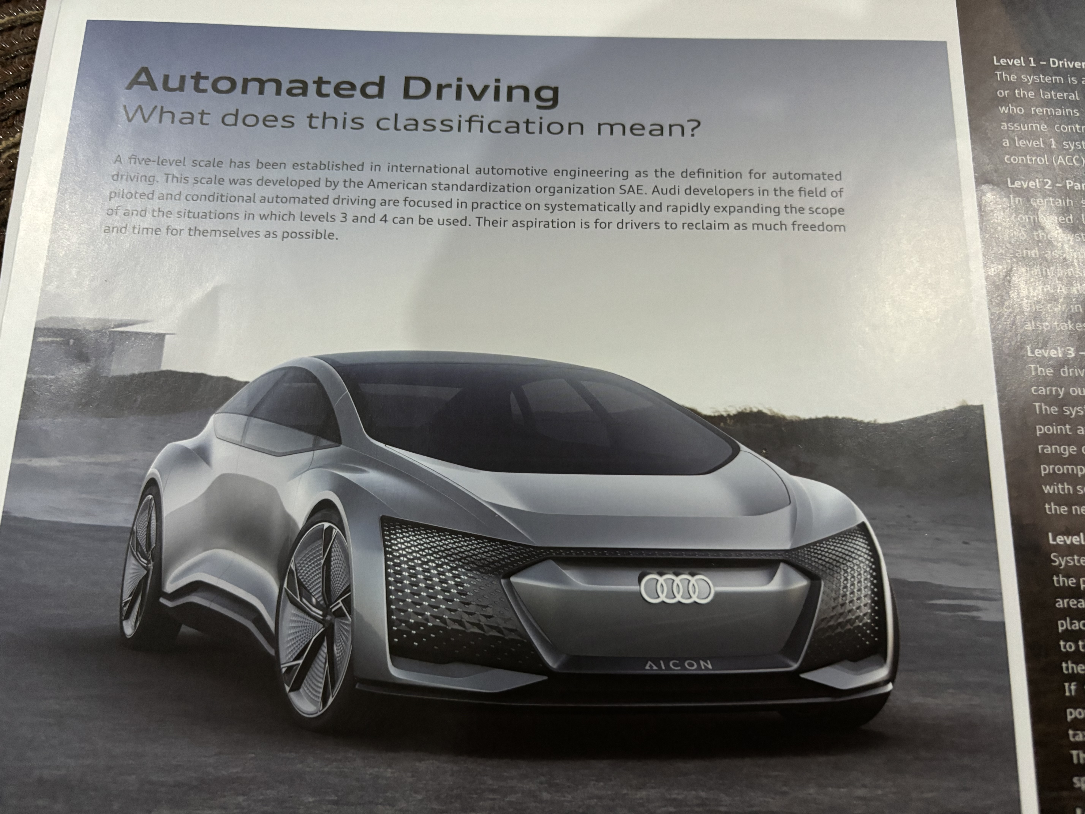
self-driving cars
A five-level scale has been set-up as a definition for automated driving.
1. – Driver Assistance
2. – Partial Automation
3. – Conditional Automation
4. – High Automation
5. – Full Automation
1 & 2 done
3 & 4 being worke on

Slide 22
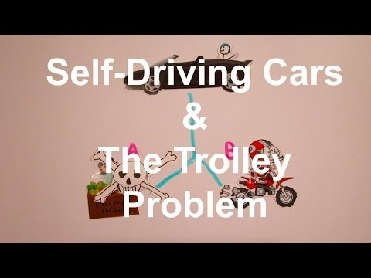

Slide 23
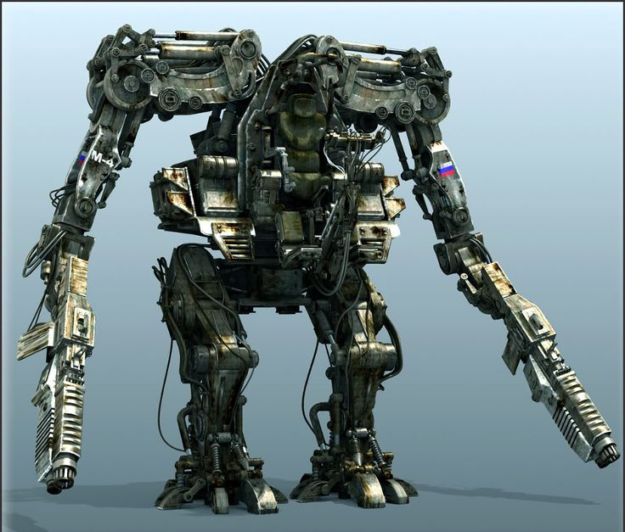
Killer robot weapons
Fully autonomous weapons, which would select and engage targets without meaningful human control, are being developed
We're running out of time to stop killer robot weapons |
Artificial iItelligence (AI) researchers, from 30 countries, are concerned that the collaboration between Korea Advanced Institute of Science and Technology (KAIST) and its partner, defence manufacturer Hanwha Systems, could lead to the development of "killer robots".
AI experts condemn development of "killer robots" in South Korea

Slide 24
Killer robot weapons
Fully autonomous weapons raise a host of concerns, such as allowing machines that cannot appreciate the value of human life to make life-and-death decisions crosses a moral red line.
Legally, the so-called “killer robots” would lack human judgment, meaning that it would be very challenging to ensure that their decisions complied with international humanitarian and human rights law.
For example, a robot could not be preprogrammed to assess the degree force to be used in every situation,.
Fully autonomous weapons also raise the question: who would be responsible for attacks that violate these laws if a human did not make the decision to fire on a specific target

Slide 25
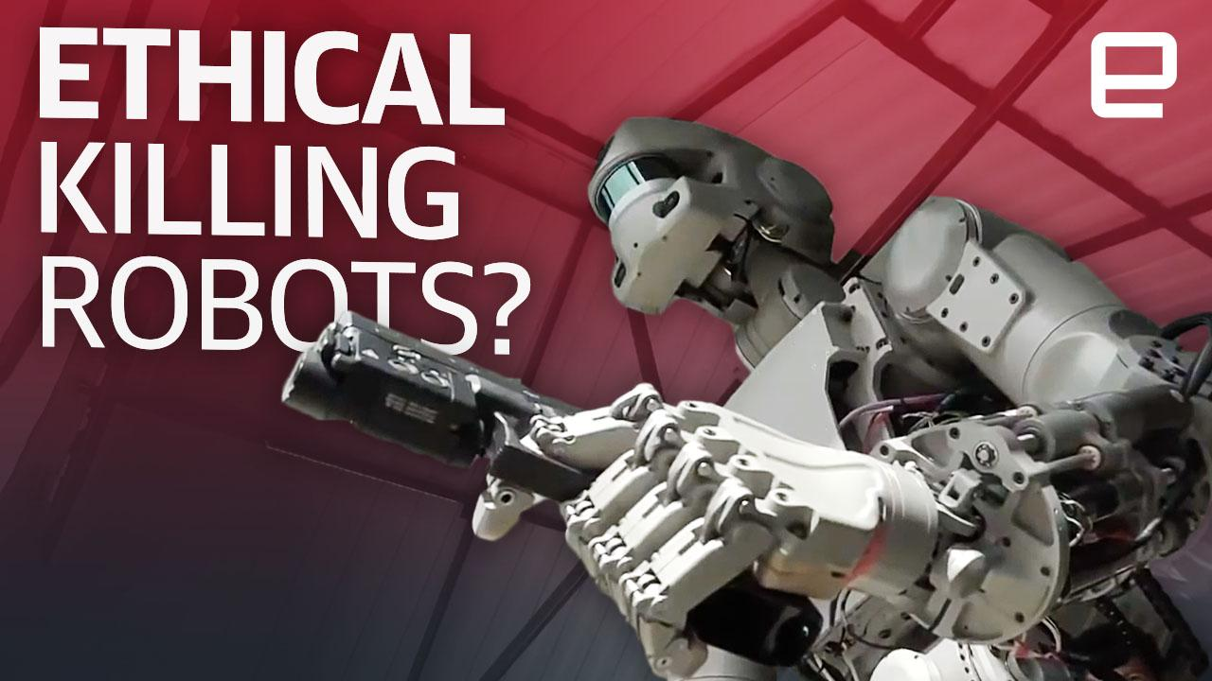
Killer robot weapons
The final concern — in many ways the simplest — is that for many people the idea of delegating a life-or-death decision to a machine, crosses a moral and ethical line.

Slide 26
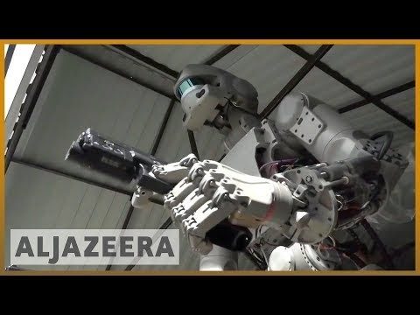

Slide 27
Ethical dilemma !!!
Ethical dilemmas, also known as a moral dilemmas, are situations in which there is a choice to be made between two options, neither of which resolves the situation in an ethically acceptable fashion.
Abortion
Euthanasia
Samaritan’s Dilemma

Slide 28
emerging technology The Dilemmas that emerge with new Technologies
TECHNOLOGY | POSITIVES | NEGATIVES
Ariel Surveillance [satellites, drones, etc] | Use of real-time images of areas affected by natural disasters Assist with law - enforcement | Abuse by governments, police in violating the privacy of the public Use by terrorist
Communications | Very fast global communications and transfer of data Collecting information to solve crime through electronic “eaves-dropping” | Violation of privacy through listening to private conversations of citizens
Electronic Justice | May help to clear back-log of cases in courts May help to overcome prejudice of race, gender, religion in sentencing | Software is written by humans, who may let their feeling over-come ethical considerations

Slide 29
emerging technology The Dilemmas that emerge with new Technologies
TECHNOLOGY | POSITIVES | NEGATIVES
Electronic Religion | Could be programmed to give sermons, or conduct funeral services, in situations where there is a shortage of clergy | Impersonal and not able to provide the pastoral care that human clergy can give a troubled person
Textalyser | Useful deterrent to prevent drivers texting while in control of vehicle. Will ensure safer road usage | Concerns that use of this device infringes on our right to be exempt from unreasonable searches and seizures.
Malware e.g. Ransomeware |  | Software specifically designed to disrupt, damage, or gain authorized access to a computer system.
Biometric Technology | Eliminates paper documentation that can be forged, like ID cards, passports, and visas, and provide a foolproof and very convenient form of identity | Possible violations of privacy and autonomy
paper documentation like ID cards, passports, and visas. Biometrics provide a very convenient form of identity

Slide 30
emerging technology The Dilemmas that emerge with new Technologies
TECHNOLOGY | POSITIVES | NEGATIVES
Self-driving Cars | Autonomous vehicles can reduce traffic, cut pollution and save many lives each year—human error contributes to 90% of traffic accidents | AI does not have the same cognitive capabilities that humans have !! Autonomous vehicles need to be protected from hackers, who may take over their controls, while someone is onboard
Killer Robot Weapons | Will reduce the loss of life military personnel in an armed conflict | “Killer robots” lack human judgment, and it will be difficult to ensure that their decisions complied with international human rights law. Who would be responsible ??? Allowing machines that cannot appreciate the value of human life to make life-and-death decisions is unethical

Slide 31
emerging technology
The beginnings of a technological revolution are already visible in six developmental categories: materials, nanotechnology, biotechnology, information technology, Neuroscience, robotics and artificial intelligence.
The world is changing faster than we are prepared for.”
The future is coming and it is coming quickly, we will need to reinvent ourselves in order to keep up.

Slide 32
MIT : 10 BREAKTHROUGH TECHNOLOGIES 2018
 | TECHNOLOGY | WHY IMPORTANT
1 | 3-D Metal Printing Now printers can make metal objects quickly and cheaply. | The ability to make large and complex metal ­objects on demand could transform manufacturing.
2 | Artificial Embryos Without using eggs or sperm cells, researchers have made embryo-like structures from stem cells alone, providing a whole new route to creating life. | Artificial embryos will make it easier for researchers to study the mysterious beginnings of a human life, but they’re stoking new bioethical debates.
3 | Sensing City A Toronto neighborhood aims to be the first place to successfully integrate cutting-edge urban design with state-of-the-art digital technology. | Smart cities could make urban areas more affordable, livable, and environmentally friendly.
4 | AI for Everybody Cloud-based AI is making the technology cheaper and easier to use. | Right now the use of AI is dominated by a relatively few companies, but as a cloud-based service, it could be widely available to many more, giving the economy a boost.

Slide 33
MIT : 10 BREAKTHROUGH TECHNOLOGIES 2018
 | TECHNOLOGY | WHY IMPORTANT
5 | Dueling Neural Networks Two AI systems can spar with each other to create ultra-realistic original images or sounds, something machines have never been able to do before. | This gives machines something akin to a sense of imagination, which may help them become less reliant on humans—but also turns them into alarmingly powerful tools for digital fakery.
6 | Babel-Fish Earbuds Near-real-time translation now works for a large number of languages and is easy to use. | In an increasingly global world, language is still a barrier to communication.
7 | Zero-Carbon Natural Gas A power plant efficiently and cheaply captures carbon released by burning natural gas, avoiding greenhouse-gas emissions. | Around 32 percent of US electricity is produced with natural gas, accounting for around 30 percent of the power sector’s carbon emissions.
8 | Perfect Online Privacy Computer scientists are perfecting a cryptographic tool for proving something without revealing the information underlying the proof. | If you need to disclose personal information to get something done online, it will be easier to do so without risking your privacy or exposing yourself to identity theft.

Slide 34
MIT : 10 BREAKTHROUGH TECHNOLOGIES 2018
 | TECHNOLOGY | WHY IMPORTANT
9 | Genetic Fortune Telling Scientists can now use your genome to predict your chances of getting heart disease or breast cancer, and even your IQ. | DNA-based predictions could be the next great public health advance, but they will increase the risks of genetic discrimination.
10 | Materials' Quantum Leap IBM has simulated the electronic structure of a small molecule, using a seven-qubit quantum compute | Understanding molecules in exact detail will allow chemists to design more effective drugs and better materials for generating and distributing energy.

Slide 35
MIT:10 BREAKTHROUGH TECHNOLOGIES 2019
 | TECHNOLOGY | IMPORTANCE
1 | Robot dexterity (DACTYL) A robot can’t yet be programmed to figure out how to grasp any object just by looking at it, as people do. | Dactyl, a robot using what’s known as reinforcement learning, neural-network software learns how to grasp and turn the block within a simulated environment
2 | New-wave nuclear power New nuclear designs that have gained momentum in the past year are aiming to make nuclear power safer and cheaper. | Small modular reactors typically produce in the tens of megawatts of power (a traditional nuclear reactor produces around 1,000 MW). The miniaturized reactors can save money and reduce environmental and financial risks.
3 | Predicting pre-mature births A simple blood test can predict if a pregnant woman is at risk of giving birth prematurely. | Test helps to identify women likely to deliver too early. Once alerted, doctors can take measures to stave off an early birth and give the child a better chance of survival.
4 | Gut probe in a pill A small, swallowable device captures detailed images of the gut without anesthesia, even in infants and children. | The device makes it easier to screen for and study gut diseases, including one that keeps millions of children in poor countries from growing properly.

Slide 36
MIT:10 BREAKTHROUGH TECHNOLOGIES 2019
 | TECHNOLOGY | IMPORTANCE
5 | Custom cancer vaccines The treatment incites the body’s natural defenses to destroy only cancer cells by identifying mutations unique to each tumor | Conventional chemotherapies take a heavy toll on healthy cells and aren’t always effective against tumors
6 | The cow-free burger Both lab-grown and plant-based alternatives approximate the taste and nutritional value of real meat without the environmental devastation. | Livestock production causes catastrophic deforestation, water pollution, and greenhouse-gas emissions
7 | Carbon dioxide catcher Practical and affordable ways to capture carbon dioxide from the air can soak up excess greenhouse-gas emissions. | Removing CO2 from the atmosphere might be one of the last viable ways to stop catastrophic climate change
f a p

Slide 37
MIT:10 BREAKTHROUGH TECHNOLOGIES 2019
 | TECHNOLOGY | IMPORTANCE
8 | An ECG on your wrist Regulatory approval and technological advances are making it easier for people to continuously monitor their hearts with wearable devices. | An electrocardiogram (ECG)—that doctors use to diagnose abnormalities before they cause a stroke or heart attack can now be detected by ECG-enabled smart watches, made possible by new regulations and innovations in hardware and software.
9 | Sanitation without sewers Energy-efficient toilets can operate without a sewer system and treat waste on the spot. | 2.3 billion people lack safe sanitation and this forces people to dump fecal matter into nearby ponds and streams, spreading bacteria, viruses, and parasites that can cause diarrhea and cholera, which can be fatal.
10 | Smooth-talking AI assistants New techniques that capture semantic relationships between words are making machines better at understanding natural language. | AI assistants can now perform conversation-based tasks like booking a restaurant reservation or coordinating a package drop-off rather than just obey simple commands

Slide 38
MIT:10 BREAKTHROUGH TECHNOLOGIES 2020
 | TECHNOLOGY | IMPORTANCE
1 | Unhackable internet An internet based on quantum physics will soon enable inherently secure communication. | The internet is increasingly vulnerable to hacking; a quantum one would be unhackable.
2 | Hyper-personalized medicine Novel drugs are being designed to treat unique genetic mutations. A hopeless case: a child with a fatal disease so exceedingly rare that not only is there no treatment, there’s not even anyone studying it | Genetic medicine tailored to a single patient means hope for people whose ailments were previously incurable.
3 | Digital money Cash is gradually dying out. Will there ever be a digital alternative that offers the same mix of convenience and freedom? | As the use of physical cash declines, so does the freedom to transact without an intermediary. Meanwhile, digital currency technology could be used to splinter the global financial system.

Slide 39
MIT:10 BREAKTHROUGH TECHNOLOGIES 2020
 | TECHNOLOGY | IMPORTANCE
4 | Anti-aging drugs These drugs won’t let you live longer (yet) but aim to treat specific ailments by slowing or reversing a fundamental process of aging. | A number of different diseases, including cancer, heart disease, and dementia, could potentially be treated by slowing aging.
5 | AI-discovered molecules The number of molecules that could be turned into potentially life-saving drugs is enormous. Now machine-learning tools can explore large databases of existing molecules and their properties, using the information to generate new possibilities. | Commercializing a new drug costs around $2.5 billion on average. One reason is the difficulty of finding promising molecules. This could make it faster and cheaper to discover new drug candidates
6 | Satellite mega-constellations Satellites that can beam a broadband connection to internet terminals. As long as these terminals have a clear view of the sky, they can deliver internet to any nearby devices | These systems can blanket the globe with high-speed internet — or turn Earth’s orbit into a junk-ridden minefield.

Slide 40
MIT:10 BREAKTHROUGH TECHNOLOGIES 2020
 | TECHNOLOGY | IMPORTANCE
7 | Quantum supremacy Quantum computers store and process data in a way differently present ones. In theory, they could tackle certain classes of problems that even the most powerful classical supercomputers would take years to solve; e.g. breaking today’s cryptographic codes or simulating molecular behavior to help discover new drugs and materials. | Eventually, quantum computers will be able to solve problems no classical machine can manage.
8 | Tiny Artificial Intelligence Research is ongoing on new algorithms to shrink existing deep-learning models without losing their capabilities. Also an emerging generation of AI chips can pack more computational power into tighter physical spaces, and run AI on far less energy. | Our devices no longer need to talk to the cloud for us to benefit from the latest AI-driven features. We can now run powerful AI algorithms on our phones.

Slide 41
MIT:10 BREAKTHROUGH TECHNOLOGIES 2020
 | TECHNOLOGY | IMPORTANCE
9 | Differential privacy The data from a national census is released in statistical tables for policymakers to use in decision making. By law, the data must not lead back to any individuals. But there are ways “de-anonymize” individuals, especially if the census data is combined with other public statistics. Differential privacy is a mathe-matical technique to protect the data | It is increasingly difficult for a national Census Bureau to keep the data it collects private. A technique called differential privacy could solve that problem, build trust, and also become a model for protection of other confidential data.
10 | Climate change attribution Researchers can now spot climate change’s role in extreme weather. This has been made possible by (i) detailed satellite data helping us understand natural systems (ii) increased computing power helps scientists to create higher-resolution simulations and conduct many more virtual experiments. | It’s providing a clearer sense of how climate change is worsening the weather, and what we will need to do to prepare for these adverse conditions

Slide 42
BREAKTHROUGH TECHNOLOGIES
 | 2020 | 2019 | 2018
IT | Unhackable internet Quantum supremacy | Robot dexterity (DACTYL) | Materials' Quantum Leap Perfect Online Privacy
MEDICINE | Hyper-personalized medicine Anti-aging drugs | Predicting pre-mature births Gut probe in a pill Custom cancer vaccines An ECG on your wrist | Artificial Embryos Genetic Fortune Telling
GOVERNMENT | Digital money Differential privacy
AI | AI-discovered molecules Tiny Artificial Intelligence | Smooth-talking AI assistants | AI for Everybody Dueling Neural Networks
COMMUNICAT-ION | Satellite mega-constellations |  | Babel-Fish Earbuds
ENVIRONMENT | Climate change attribution | The cow-free burger Carbon dioxide catcher Sanitation without sewers | Sensing City
ENGINEERING |  | New-wave nuclear power | 3-D Metal Printing Zero-Carbon Natural Gas

Slide 43
BREAKTHROUGH TECHNOLOGIES
The Massachusetts Institute of Technology’s [MIT] ratings of technologies that will have the biggest impact on the world are in the fields of :
Medicine (8 nos)
Environment, AI, IT (5 nos each)
Engineering (3 nos)
More details of the MIT breakthrough technologies for 2018 to 2020 and the 2021 BTs are on internet, and it is recommended that students read these

Slide 44
ACKNOWLEDGEMENT
http://ethicsandtechnology.eu/wp-content/uploads/downloadable-content/Brey-2017-Ethics-Emerging-Tech.p
https://en.wikipedia.org/wiki/Nineteen_Eighty-Four
https://news.nd.edu/news/reilly-center-releases-its-2018-top-10-list-of-ethical-dilemmas-in-science-and-technology
http://pellcenter.org/the-ethical-challenges-of-new-technologies/
https://www.theguardian.com/.../2018/.../killer-robot-weapons-autonomous-ai-warfare-u...
https://bizfluent.com › Entrepreneurship
https://www.technologyreview.com/lists/technologies/2018/
https://youtu.be/hLoF5_-OUKY
https://www.technologyreview.com/lists/technologies/2019/
https://www.technologyreview.com/lists/technologies/2020/
https://www.securityinfowatch.com/access-identity/biometrics/article/21072152/ethics-and-biometric-identity
Ethical Issues in Biometrics Isaac Cooper, M.S.; Jimmy Yon, M.S. https://www.researchgate.net/publication/335768067_Ethical_Issues_in_Biometrics
Audi Quarterly Newsletter5

Slide 45

AN ETHICAL DILEMA ????

Slide 46
THANK YOU !!!!

